Slide 1


Bharati Vidyapeeth
(Deemed to be University)
College of Engineering, Pune
DEPARTMENT OF INFORMATION TECHNOLOGY
TOPIC : “Dual Axis Solar Tracker System”
Under the guidance of
Prof. Prakash Devale
ROLL NO. | NAME | PRN
66 | RAHUL KUMAR | 2414111034

Slide 2

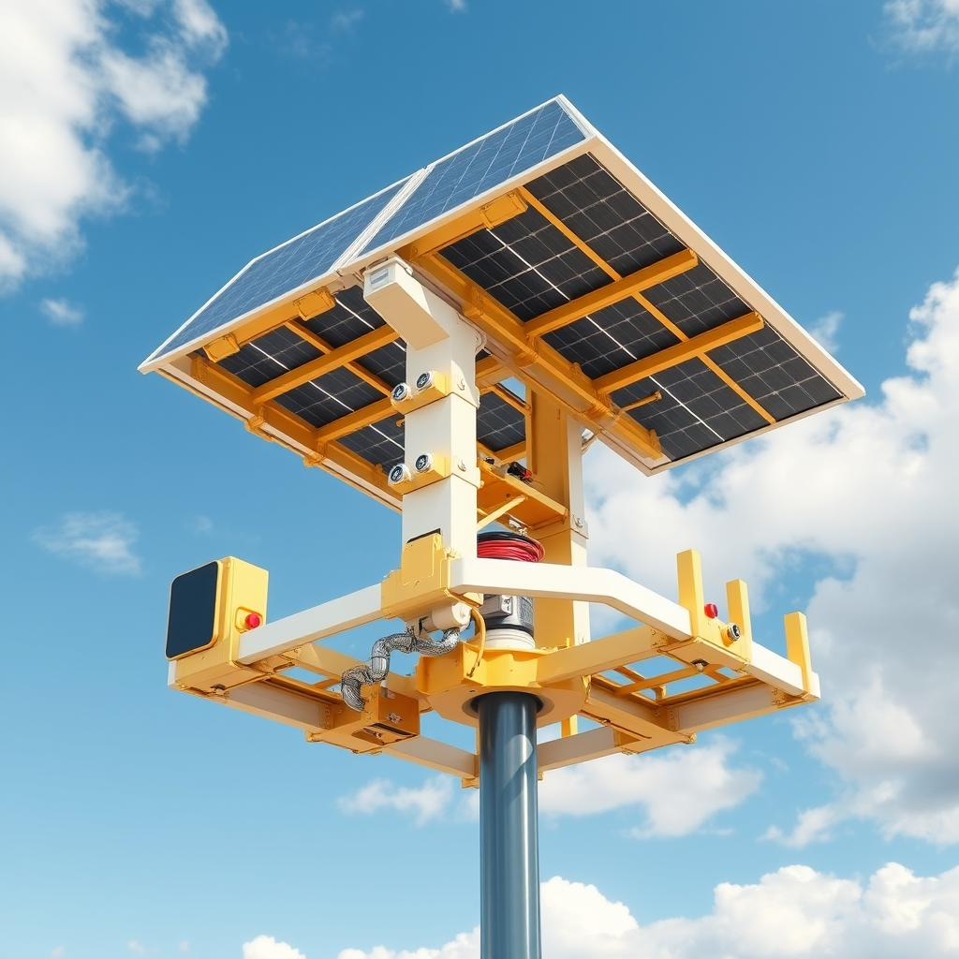
IDEA TITLE
DUAL AXIS SOLAR TACKER SYSTEM USING ARDUINO UNO
Solar tracker systems are designed to enhance the efficiency of solar panels by continuously adjusting their position to capture the maximum amount of sunlight throughout the day.
Dual-axis trackers offer more precise movement than single-axis or fixed solar panels, allowing them to follow the sun more accurately and produce more energy throughout the day.
Implementing dual-axis trackers significantly increases energy production compared to single-axis or fixed systems.

Slide 3
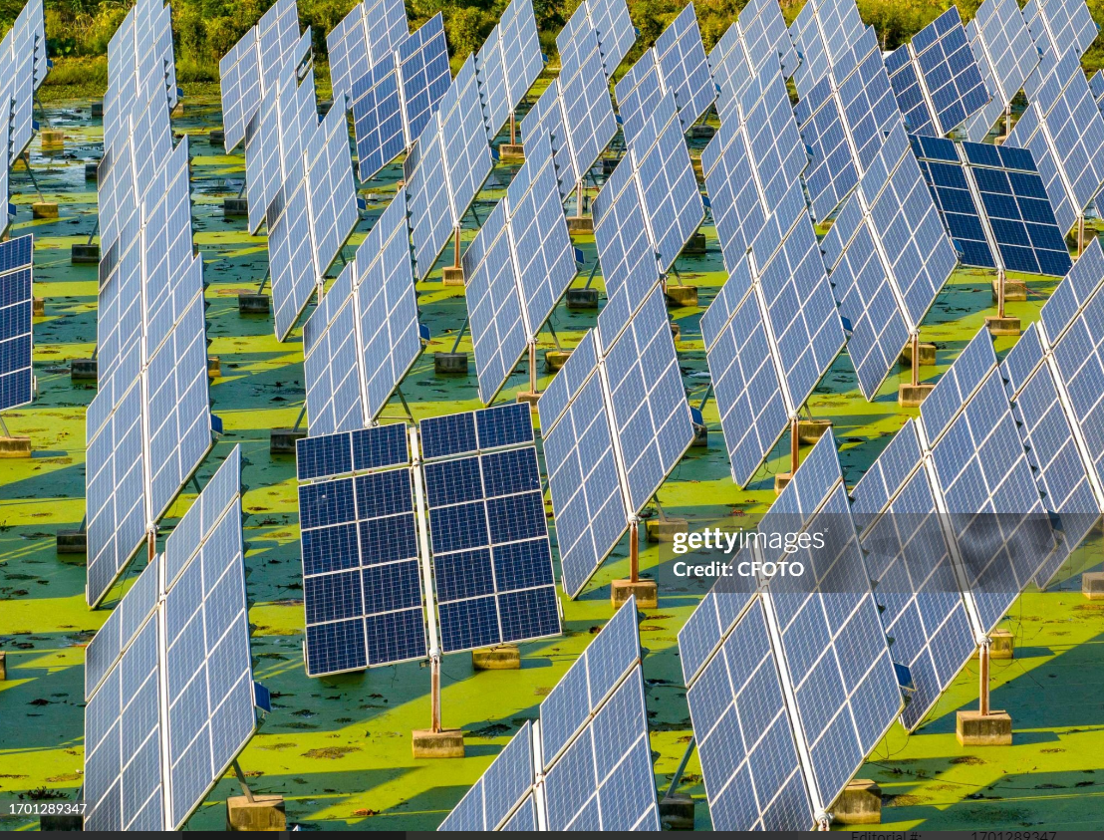
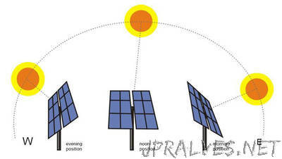
Introduction to Solar Tracker Systems
Solar Energy Optimization
Solar tracker systems play a crucial role in maximizing the efficiency of solar panels by constantly adjusting their position to capture the most sunlight.
2. Types of Trackers
Fixed panels: No movement , stay in one position
Single-axis trackers: Adjust along one axis
Dual –axis tracker : Adjust along both axes for maximum sunlight capture
Application
Residental : Used in home solar installation to increase energy efficiency
Commerical: Deployed in solar farms for businesses to reduce energy loss
Industruial : Utilized in large-scale powerplants to maximize renewablae enery production

Slide 4
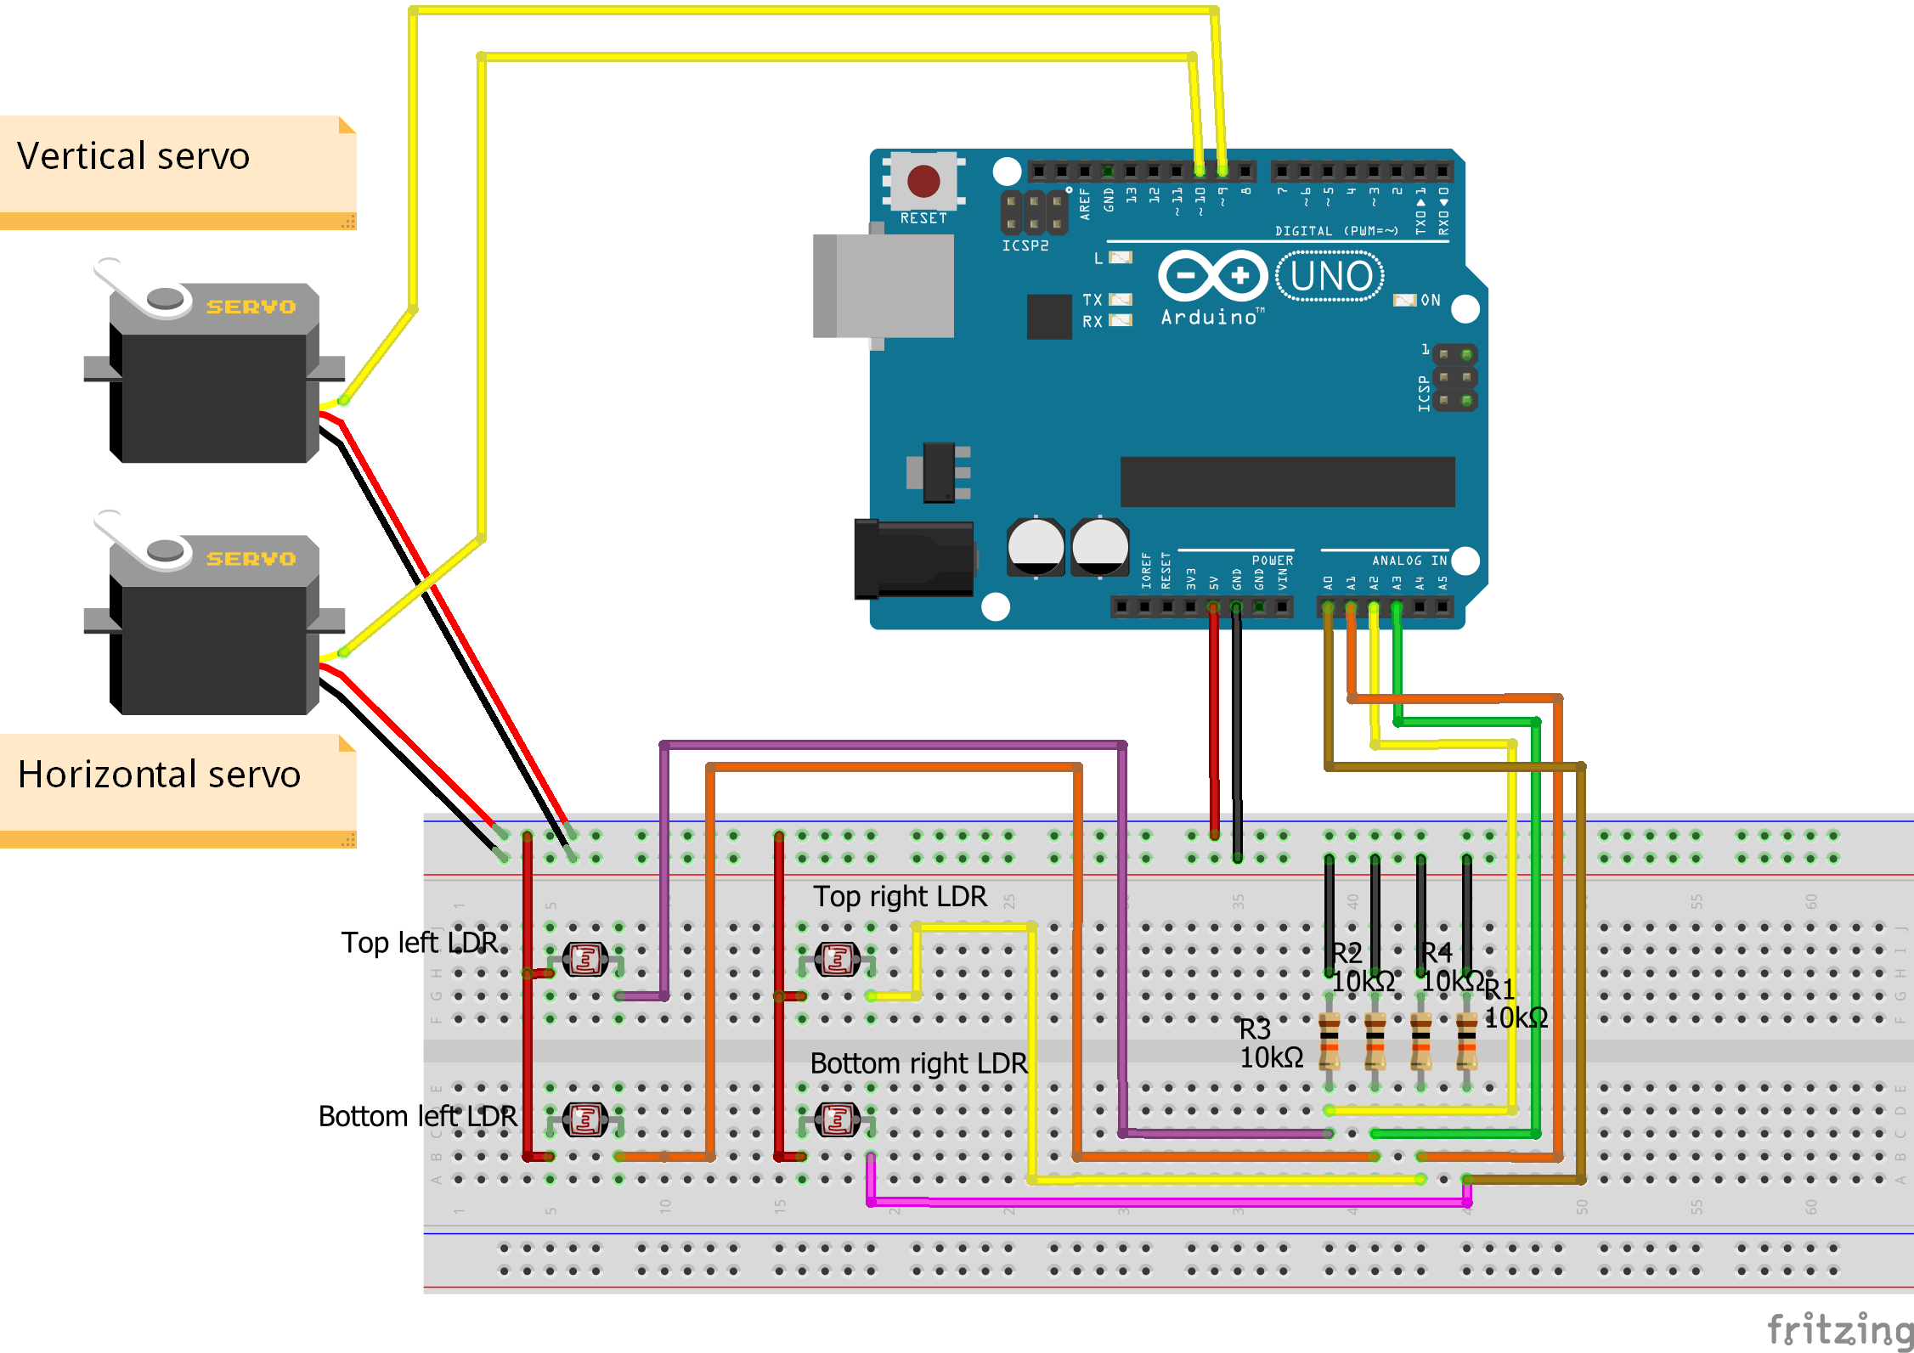
Components and Circuit Design
Arduino Uno
The microcontroller that controls the system.
Servo Motors
Responsible for rotating the solar panel along both the horizontal and vertical axes.
LDR (Light-Dependent Resistors)
Used to detect the light energy’s position and provide feedback to the Arduino Uno.
Resistors
Used with LDRs to create a voltage divider, ensuring accurate light intensity readings while protecting the Arduino from excessive current.
Jumper Wires
Flexible wires that connect the Arduino, servo motors, and LDRs, allowing for quick and easy circuit assembly and modifications.
Circuit Diagram

Slide 5
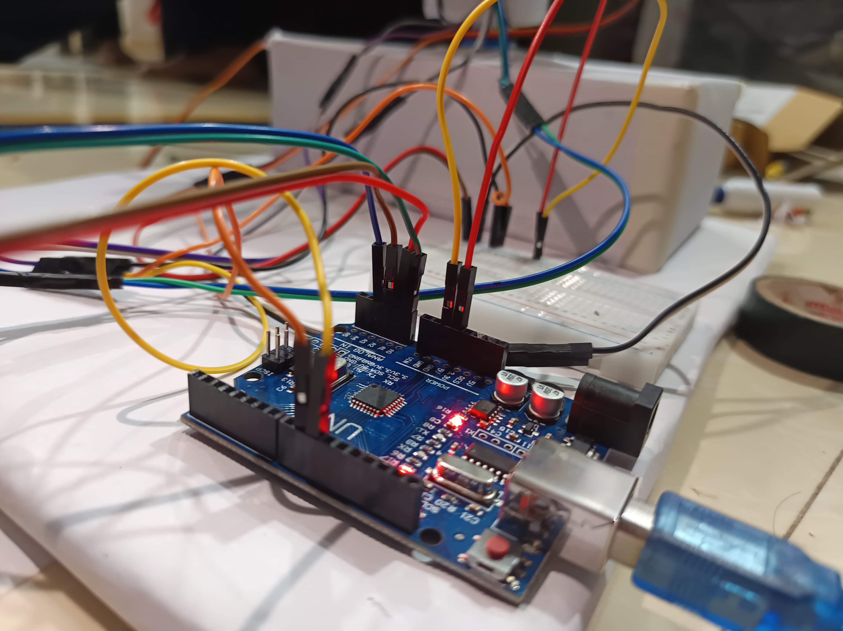
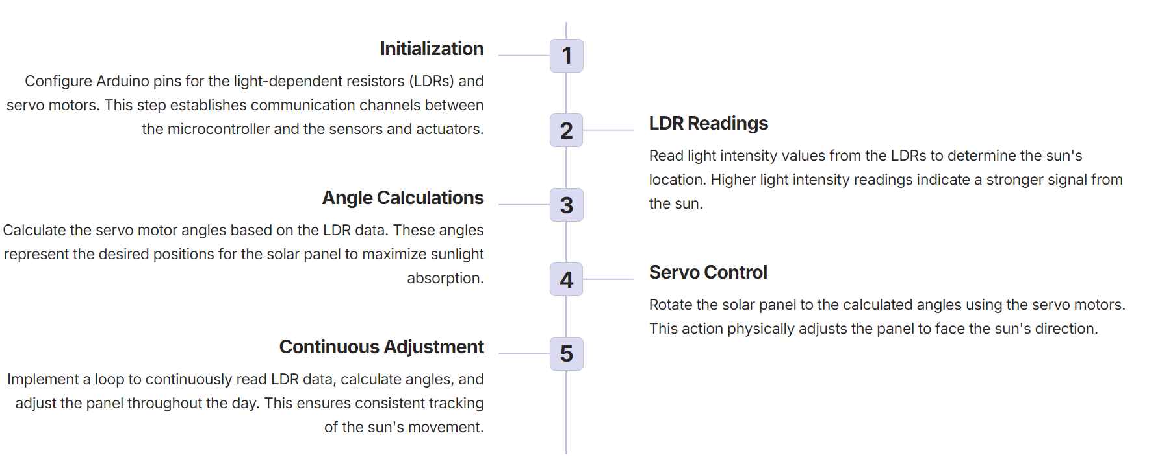
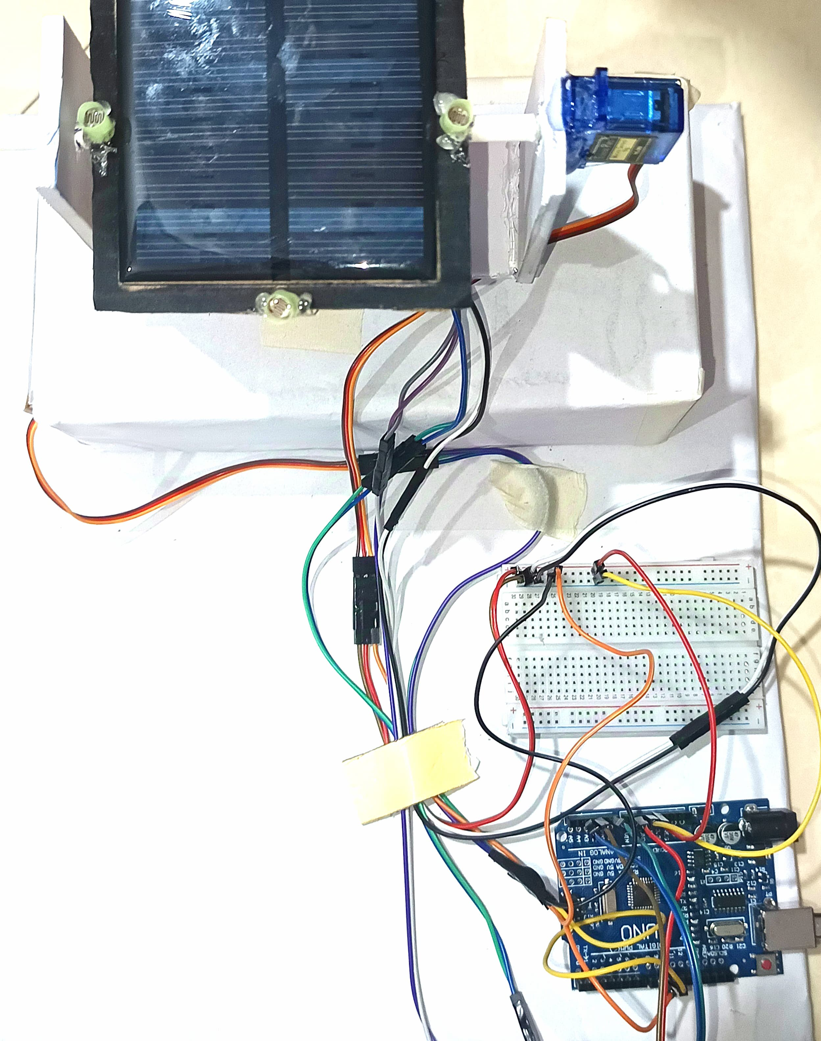
Step-by-Step Process of Solar Tracking

Slide 6

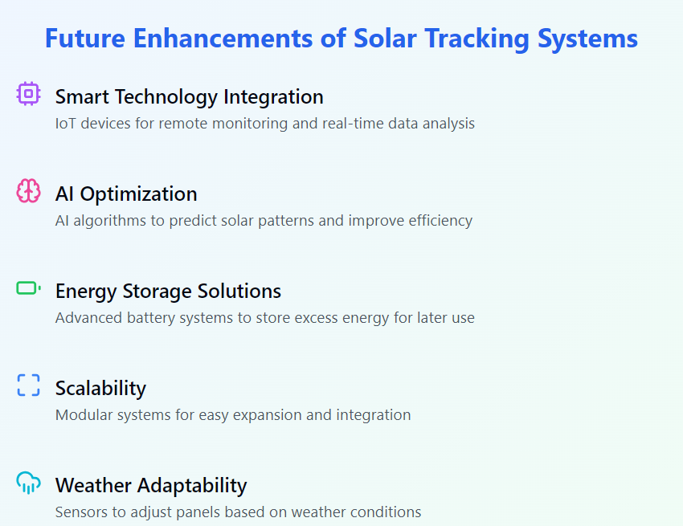
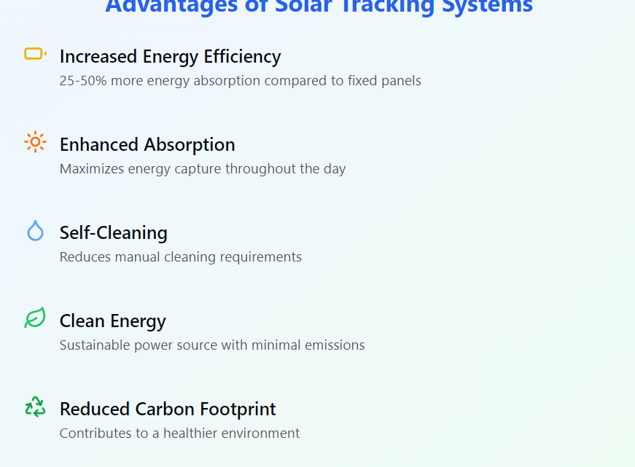

Solar Tracking System

